Slide 1
CENG 477 Introduction to Computer Graphics
Viewing Transformations

Slide 2

Introduction
Until now, we learned how to position the objects in the 3D world space by modeling transformations
With viewing transformations, we position the objects on a 2D image as seen by a camera with arbitrary position and orientation
Composed of three parts:
Camera (or eye) transformation
Projection transformation
Viewport transformation
$$\left[\begin{matrix}x_{vp} \\ y_{vp} \\ z_{vp}\end{matrix}\right]=M_{vp}M_{per}M_{cam}\left[\begin{matrix}x_{w} \\ y_{w} \\ z_{w} \\ 1\end{matrix}\right]$$

Slide 3
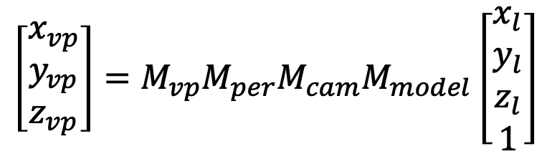
Introduction
Until now, we learned how to position the objects in the 3D world space by modeling transformations
With viewing transformations, we position the objects on a 2D image as seen by a camera with arbitrary position and orientation
Composed of three parts:
Camera (or eye) transformation
Projection transformation
Viewport transformation
$$\left[\begin{matrix}x_{vp} \\ y_{vp} \\ z_{vp}\end{matrix}\right]=M_{vp}M_{per}M_{cam}M_{model}\left[\begin{matrix}x_{l} \\ y_{l} \\ z_{l} \\ 1\end{matrix}\right]$$

Slide 4
Introduction
With viewing transformations, we are now transitioning from the backward rendering pipeline (aka. ray tracing) to forward rendering pipeline (aka. object-order, rasterization, z-buffer)
Camera
Camera
Backward rendering
Forward rendering

Slide 5
Camera Transformation
Goal: Given an arbitrary camera position e and camera vectors uvw, determine the camera coordinates of points given by their world coordinates
u
What are the coordinates of this
cube with respect to the uvw CS?
v
y
e
w
(0,0,0)
x
z

Slide 6
Camera Transformation
Transform everything such that uvw aligns with xyz
y
v
u
u
y
v
e
(0,0,0)
e
x
w
(0,0,0)
w
x
z
z

Slide 7

Camera Transformation
Step 1: Translate e to the world origin (0, 0, 0)
$$T= \left[\begin{matrix}1 & 0 & 0 & −e_{x} \\ 0 & 1 & 0 & −e_{y} \\ 0 & 0 & 1 & −e_{z} \\ 0 & 0 & 0 & 1\end{matrix}\right]$$
y
v
u
e
x
z
w

Slide 8

Camera Transformation
Step 2: Rotate uvw to align it with xyz:
$$R= \left[\begin{matrix}u_{x} & u_{y} & u_{z} & 0 \\ v_{x} & v_{y} & v_{z} & 0 \\ w_{x} & w_{y} & w_{z} & 0 \\ 0 & 0 & 0 & 1\end{matrix}\right]$$
y
We already learned
how to do this in
modeling transformations!
v
u
e
x
w
z

Slide 9
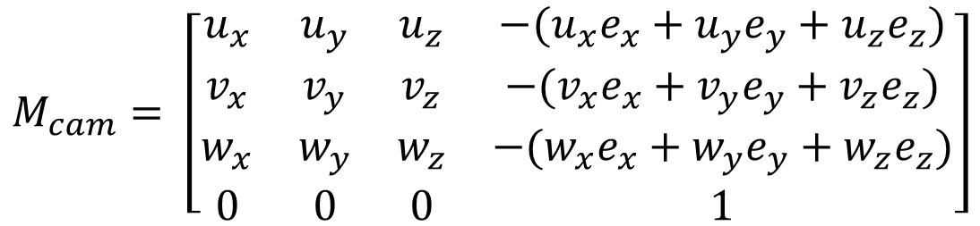
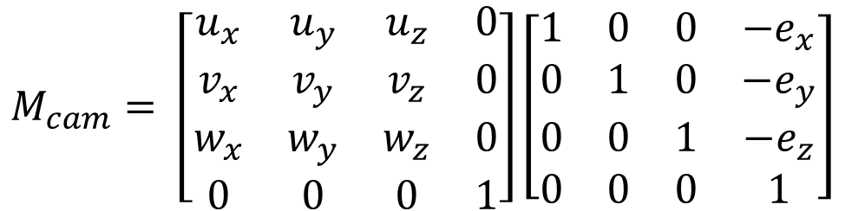
Camera Transformation
The composite camera transformation is:
aka Viewing Transformation Matrix
$$M_{cam}= \left[\begin{matrix}u_{x} & u_{y} & u_{z} & 0 \\ v_{x} & v_{y} & v_{z} & 0 \\ w_{x} & w_{y} & w_{z} & 0 \\ 0 & 0 & 0 & 1\end{matrix}\right]\left[\begin{matrix}1 & 0 & 0 & −e_{x} \\ 0 & 1 & 0 & −e_{y} \\ 0 & 0 & 1 & −e_{z} \\ 0 & 0 & 0 & 1\end{matrix}\right]$$
$$M_{cam}= \left[\begin{matrix}u_{x} & u_{y} & u_{z} & −(u_{x}e_{x}+u_{y}e_{y}+u_{z}e_{z}) \\ v_{x} & v_{y} & v_{z} & −(v_{x}e_{x}+v_{y}e_{y}+v_{z}e_{z}) \\ w_{x} & w_{y} & w_{z} & −(w_{x}e_{x}+w_{y}e_{y}+w_{z}e_{z}) \\ 0 & 0 & 0 & 1\end{matrix}\right]$$

Slide 10
Camera Transformation
When points are multiplied with this matrix, their resulting coordinates will be with respect to the uvw-e coordinate system (i.e. the camera coordinate system)
Next, we need to apply a projection transformation

Slide 11


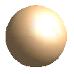

Projection Transformation
Projection: 3D to 2D. Perspective or parallel.
y_{view}
x_{view}
z_{view}
P₂
P₂
P₂`
P₂`
Convergence
Point
P₁
P₁`
P₁
P₁`

Slide 12
Projection Transformation
Classification of projections. Based on:
Center of projection: infinity (parallel) or a point (perspective)
Projection lines wrt. projection plane: orthogonal (orthographic), another angle (oblique)
See https://youtu.be/zuOWmbAIOmI
Center of projection
Projection plane
Projection plane
Projection plane
Center of projection
Center of projection
Perspective
Orthographic
Oblique

Slide 13
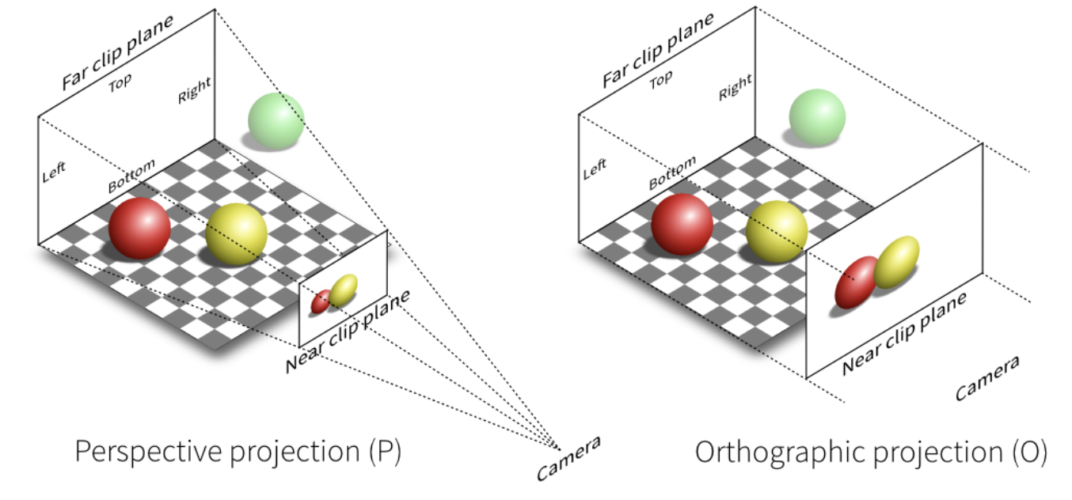
Projection Transformation
Perspective: objects which are far away are smaller than those nearby (more info about depth)
Orthographic: all objects appear at the same scale.

Slide 14
Orthographic Transformation
In both types of projections, our goal is to transform a given viewing volume to the canonical viewing volume (CVV):
y
y
v
(1, 1, 1)
z
w
(r, t, -f)
z
(0, 0, 0)
(0, 0, 0)
(l, b, -n)
(-1, -1, -1)
u
x
x
Note that n and f are typically given as distances which are
always positive and because we are looking towards the –z direction,
the actual coordinates become –n and -f
Think of it as compressing a box

Slide 15
Orthographic Transformation
In both types of projections, our goal is to transform a given viewing volume to the canonical viewing volume (CVV):
y
y
v
(1, 1, 1)
z
w
(r, t, -f)
z
(0, 0, 0)
(0, 0, 0)
(l, b, -n)
(-1, -1, -1)
u
x
x
Also note the change in the z-direction. This makes objects
further away from the camera to have larger z-values. In
other words, CVV is a left-handed coordinate system.

Slide 16

Orthographic Projection
We need to map the box with corners at (l, b, -n) and (r, t, -f) to the (-1, -1, -1) and (1, 1, 1) of CVV
This is accomplished by the following matrix:
$$M_{orth}= \left[\begin{matrix}\frac{2}{r −l} & 0 & 0 & −\frac{r+l}{r −l} \\ 0 & \frac{2}{t −b} & 0 & −\frac{t+b}{t −b} \\ 0 & 0 & −\frac{2}{f−n} & −\frac{f+n}{f −n} \\ 0 & 0 & 0 & 1\end{matrix}\right]$$
Make sure you understand how to derive this!

Slide 17
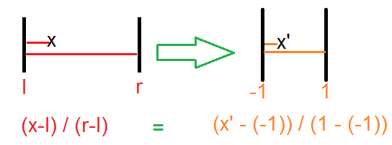

Orthographic Projection
We need to map the box with corners at (l, b, -n) and (r, t, -f) to the (-1, -1, -1) and (1, 1, 1) of CVV
This is accomplished by the following matrix:
Hint for derivation:
$$M_{orth}= \left[\begin{matrix}\frac{2}{r −l} & 0 & 0 & −\frac{r+l}{r −l} \\ 0 & \frac{2}{t −b} & 0 & −\frac{t+b}{t −b} \\ 0 & 0 & −\frac{2}{f−n} & −\frac{f+n}{f −n} \\ 0 & 0 & 0 & 1\end{matrix}\right]$$

Slide 18
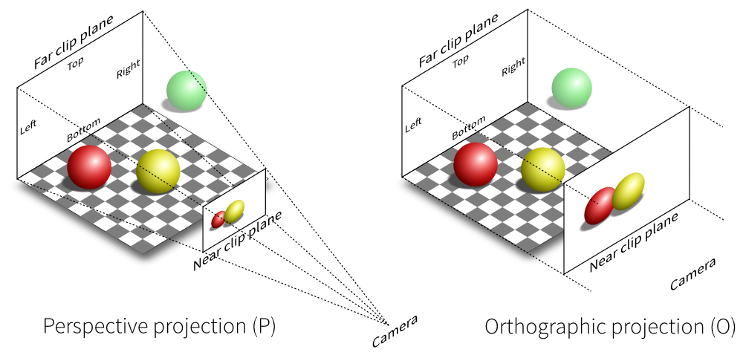
Perspective Projection
Perspective projection models how we see the real world
Objects appear smaller with distance
script-tutorials.com

Slide 19
Perspective Projection
We still have the same 6 parameters
t
l
Camera
b
r
Near
distance (n)
Far
distance (f)

Slide 20
Perspective Projection
To map to the canonical viewing volume (CVV), we take a two step approach:
Step 1: Map perspective to orthographic viewing volume
Step 2: Map orthographic to CVV
y
(1, 1, 1)
(r, t, -f)
(0, 0, 0)
z
(l, b, -n)
(l, b, -n)
(-1, -1, -1)
(r, t, -n)
x
Think of this as compressing a box where
you have to apply more pressure towards the back
We already know how to
perform the second step!

Slide 21
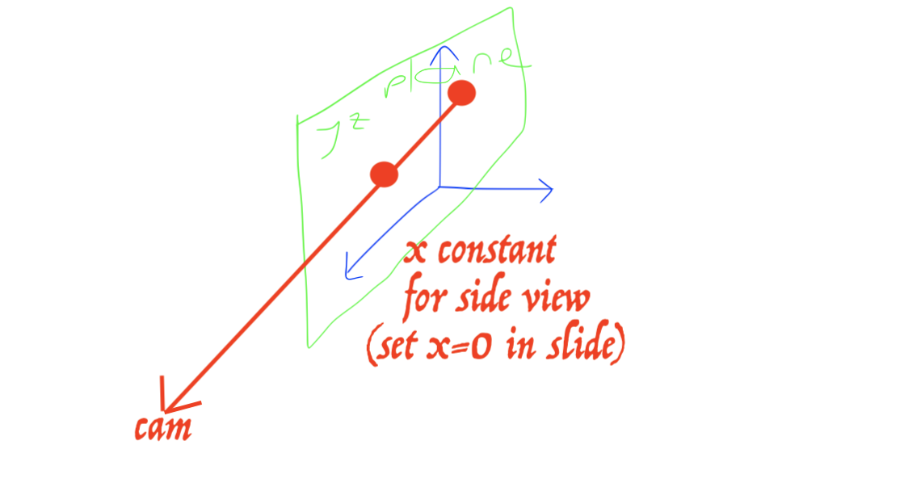




Perspective Projection
The key observation is that more distant objects should shrink proportional to their distance to the camera
Here is a side view (therefore x is constant):
$$\frac{y^{′}}{y}=\frac{−n}{z}$$
$$y^{′}=\frac{−n}{z}y$$
What is y’?
The same geometrical config.
applies to x dimension as well:
(x, t, -n)
(x, y, z)
(x, y’, -n)
$$\frac{x^{′}}{x}=\frac{−n}{z}$$
$$x^{′}=\frac{−n}{z}x$$
(x, 0, 0)
(x, 0, -n)
(x, 0, -f)
Let’s ignore the z dimension
for the moment

Slide 22

Perspective Projection
This can also be represented as a matrix multiplication thanks to homogeneous coordinates:
Why does this work?
$$M_{p2o}= \left[\begin{matrix}n & 0 & 0 & 0 \\ 0 & n & 0 & 0 \\ 0 & 0 & A & B \\ 0 & 0 & −1 & 0\end{matrix}\right]$$

Slide 23


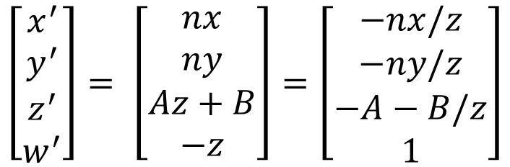
Perspective Projection
Let’s multiply a point [x, y, z, 1]^{T} with this matrix:
$$\left[\begin{matrix}x^{′} \\ y^{′} \\ z^{′} \\ w^{′}\end{matrix}\right]= \left[\begin{matrix}n & 0 & 0 & 0 \\ 0 & n & 0 & 0 \\ 0 & 0 & A & B \\ 0 & 0 & −1 & 0\end{matrix}\right]\left[\begin{matrix}x \\ y \\ z \\ 1\end{matrix}\right]$$
$$\left[\begin{matrix}x^{′} \\ y^{′} \\ z^{′} \\ w^{′}\end{matrix}\right]= \left[\begin{matrix}nx \\ ny \\ Az+B \\ −z\end{matrix}\right]$$
Remember that in homogenous coordinates, scaling all components by
the same factor does not change the point. So divide by the last comp.
$$\left[\begin{matrix}x^{′} \\ y^{′} \\ z^{′} \\ w^{′}\end{matrix}\right]= \left[\begin{matrix}nx \\ ny \\ Az+B \\ −z\end{matrix}\right]=\left[\begin{matrix}−nx/z \\ −ny/z \\ −A−B/z \\ 1\end{matrix}\right]$$

Slide 24
Perspective Projection
For the z-axis, we have the following constrains:
(–n) maps to (–n)
(–f) maps to (–f)
We can solve for A and B using these constrains
(r, t, -f)
(l, b, -n)
(l, b, -n)
(r, t, -n)

Slide 25





Perspective Projection
Remember that we had:
Now plug (-n) and (-f) and solve for the unknowns:
$$z^{′}=−A−B/z$$
$$−n=−A+B/n$$
$$A=f+n$$
$$−f=−A+B/f$$
$$B=fn$$

Slide 26

Perspective Projection
The final perspective to orthographic matrix becomes:
Note that this was Step 1
In step 2, we multiply this matrix with the orthographic to canonical viewing volume transformation matrix
$$M_{p2o}= \left[\begin{matrix}n & 0 & 0 & 0 \\ 0 & n & 0 & 0 \\ 0 & 0 & f+n & fn \\ 0 & 0 & −1 & 0\end{matrix}\right]$$

Slide 27


Perspective Projection
The final perspective projection transformation matrix is:
$$M_{per}=M_{orth}M_{p2o}$$
$$M_{per}= \left[\begin{matrix}\frac{2n}{r −l} & 0 & \frac{r+l}{r −l} & 0 \\ 0 & \frac{2n}{t −b} & \frac{t+b}{t −b} & 0 \\ 0 & 0 & −\frac{f+n}{f−n} & −\frac{2fn}{f −n} \\ 0 & 0 & −1 & 0\end{matrix}\right]$$

Slide 28
Orthographic Projection
The final orthographic projection transformation matrix is:
$$M_{orth}= \left[\begin{matrix}\frac{2}{r −l} & 0 & 0 & −\frac{r+l}{r −l} \\ 0 & \frac{2}{t −b} & 0 & −\frac{t+b}{t −b} \\ 0 & 0 & −\frac{2}{f−n} & −\frac{f+n}{f −n} \\ 0 & 0 & 0 & 1\end{matrix}\right]$$

Slide 29
Viewport Transformation
After perspective transformation, all objects inside the viewing volume are transformed into CVV
Viewport transformation maps them to the screen (window) coordinates
(0, 0)
Viewport
y
(1, 1, 1)
(0, 0, 0)
z
n_{y}
(-1, -1, -1)
x
n_{x}
(n_{x}-1, n_{y}-1)

Slide 30

Viewport Transformation
x values in range [-1,1] are transformed to [-0.5, n_{x}-0.5]
y values in range [-1,1] are transformed to [-0.5, n_{y}-0.5]
z values in range [-1,1] are transformed to [0,1] for later usage
$$M_{vp}= \left[\begin{matrix}\frac{n_{x}}{2} & 0 & 0 & \frac{n_{x}−1}{2} \\ 0 & \frac{n_{y}}{2} & 0 & \frac{n_{y}−1}{2} \\ 0 & 0 & \frac{1}{2} & \frac{1}{2}\end{matrix}\right]$$
Note that we don’t need to preserve the w component anymore

Slide 31
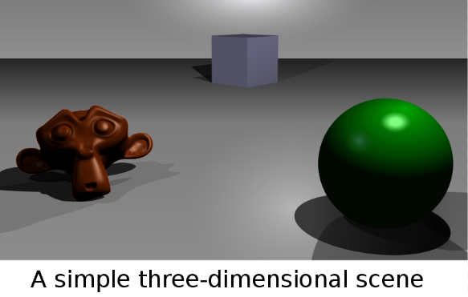
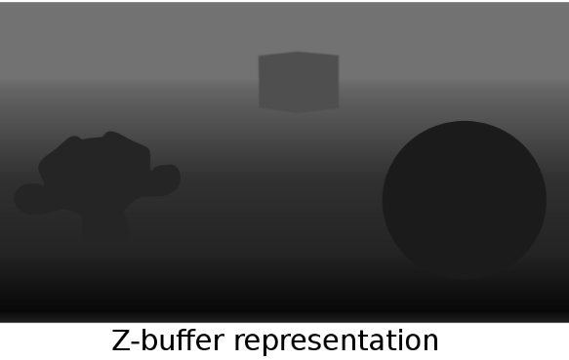
Viewport Transformation
x values in range [-1,1] are transformed to [-0.5, n_{x}-0.5]
y values in range [-1,1] are transformed to [-0.5, n_{y}-0.5]
z values in range [-1,1] are transformed to [0,1] for later usage:
Z-buffer (aka depth buffer): quick and robust decision for who is in front of who //solves the visibility problem

Slide 32
Viewport Transformation
x values in range [-1,1] are transformed to [-0.5, n_{x}-0.5]
y values in range [-1,1] are transformed to [-0.5, n_{y}-0.5]
z values in range [-1,1] are transformed to [0,1] for later usage:
Z-buffer (aka depth buffer): quick and robust decision for who is in front of who //solves the visibility problem
Z-buffer is based on the z-coordinates in the viewport ([0,1]), not in the world coordinates
World coordinates are defined for 3 corners of a triangle; it is inefficient to fill the inside of the triangle in the world space because
A big 3D triangle, after all the 3D to 2D transformations, may be behind an object in viewport so will not be visible in 2D at all; hence a fill in 3D is useless
A long 3D triangle may be mapped to a small 2D triangle in the viewport
Fast (hardware-level) rasterization algorithms to fill the inside of a 2D viewport triangle (compared to filling a triangle hanging in 3D)

Slide 33
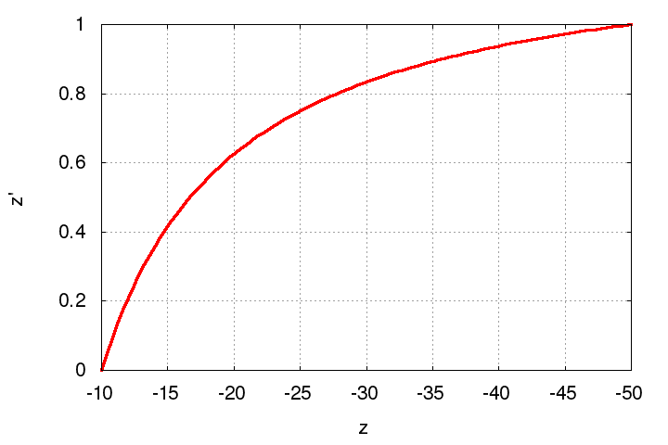
Z-Fighting
Note that the z-values get compressed to [0, 1] range from the [-n:-f] range
Observe how it looks for n = 10 and f = 50

Slide 34
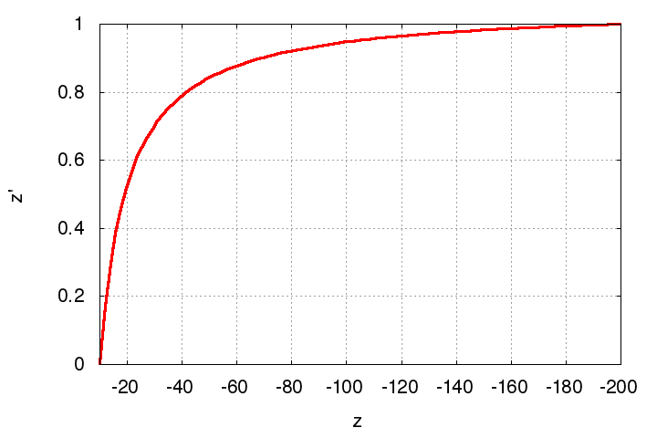
Z-Fighting
Note that the z-values get compressed to [0, 1] range from the [-n:-f] range
Observe the same for n = 10 and f = 200

Slide 35
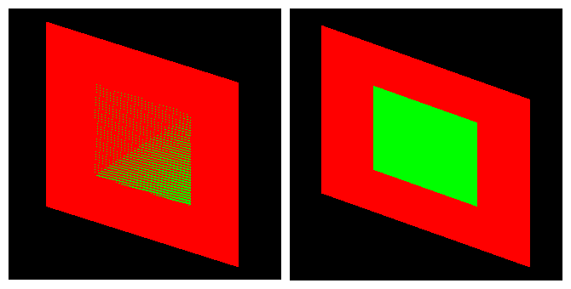
Z-Fighting
The compression is more severe for with larger depth range
This may cause a problem known as z-fighting:
Objects with originally different z-values get mapped to the same final z-value (due to limited precision) making it impossible to distinguish which one is in front and which one is behind

Slide 36
Z-Fighting
The compression is more severe for with larger depth range
This may cause a problem known as z-fighting:
Problem is even worse if the input z-values are very close to begin with
To avoid z-fighting, the depth range should be kept as small as possible for keeping the compressing less severe

Slide 37
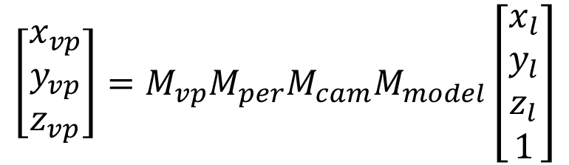

Summary
A point [x_{w}, y_{w}, z_{w}]^{T} in the world coordinate system can be transformed to its viewport coordinates by:
If the point is defined in its local coordinate system and we are given modeling transformations we use:
$$\left[\begin{matrix}x_{vp} \\ y_{vp} \\ z_{vp}\end{matrix}\right]=M_{vp}M_{per}M_{cam}\left[\begin{matrix}x_{w} \\ y_{w} \\ z_{w} \\ 1\end{matrix}\right]$$
$$\left[\begin{matrix}x_{vp} \\ y_{vp} \\ z_{vp}\end{matrix}\right]=M_{vp}M_{per}M_{cam}M_{model}\left[\begin{matrix}x_{l} \\ y_{l} \\ z_{l} \\ 1\end{matrix}\right]$$

